Slide 1

Email Spam Classifier Project
Presented By: Safiya Firdose Khan

Slide 2
Agenda:
Introduction
Problem Statement
Objective
Exploratory Data Analysis (EDA)
Visualization
Inference
Future Work

Slide 3
Acknowledgement:
I would like to express my sincere thanks of gratitude to my mentors from Data Trained academy and Flip Robo Technologies,
Bangalore for letting me work on this project. Their suggestions and directions have helped me in the completion of this project successfully. All the required information & the dataset are provided by Flip Robo Technologies.
Finally, I would like to thank my family and friends who have helped me with their valuable suggestions and guidance and have been very helpful in various stages of project completion.

Slide 4
Overview:
In this particular presentation we will be looking on:
How to analyze the dataset of Email Spam Classifier.
What are the EDA steps in cleaning the dataset.
Overall analysis on the problem.
Model building from the cleaned dataset.
Predictions for test dataset from saved model.

Slide 5
Introduction:
Today, spam has become a big internet issue and in recent times, it has been proven through statistics that spam has accounted more than 60% of all SMS movement. Furthermore, phishing spam messages has been causing problem for the security of end users, since they attempt to persuade them to surrender personal information such as passwords and bank account numbers, using parody messages which replicates the appearance of original message from trustworthy organizations. Data science can thus play a key role in this domain by protecting the users from such fraud SMS using various natural language processing techniques.

Slide 6
Objective:
The objective of identification of Spam emails are:
To give knowledge to the user about the fake e-mails and relevant e-mails.
To classify whether an email is spam or not.

Slide 7
Scope of this Project:
It provides sensitivity to the client and adapts well to the future spam techniques.
It considers a complete message instead of single words with resoect to its organization.
It increases Security and Control.
It reduces IT Administration Costs.
It also reduces Network Resource Costs.

Slide 8
Dataset description:
The dataset consists of 5572 rows and 2 columns. Primarily, it has 5 columns, where 3 columns, i.e., “Unnamed: 2”, “Unnamed: 3” and “Unnamed:4” are unnecessary. After deleting these 3 columns, the dataset consists of 2 columns, i.e., “v1” and “v2”. I have renamed the column “v1” as “label”, and the column “v2” as “message”. Later the dataset is divided into two parts, training and testing. After determine the proper model, the model is applied to predict the target variable for the test dataset.

Slide 9


Data pre-processing:
Encoding:
Converting upper case to lower case:

Slide 10
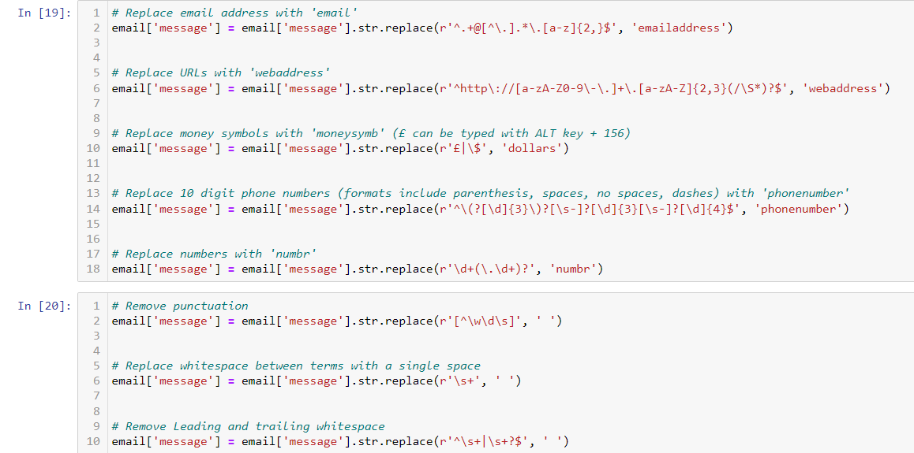
Text normalisation: it includes removing punctuation and symbols.

Slide 11
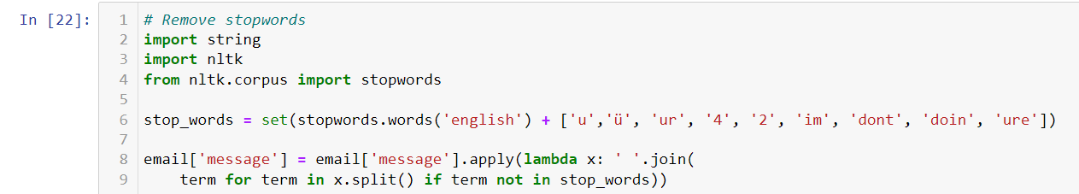
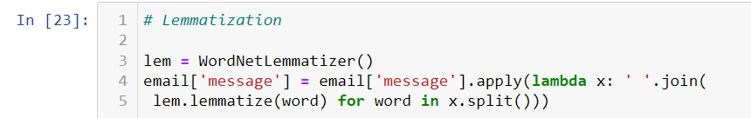
Stop word Removal : Stop words are those words that are frequently used in both written and verbal communication and thereby do not have either a positive/negative impact on our statement.
Lemmatisation: lemmatisation is the process of grouping together of different inflated form words so they can be analysed as a single item.

Slide 12
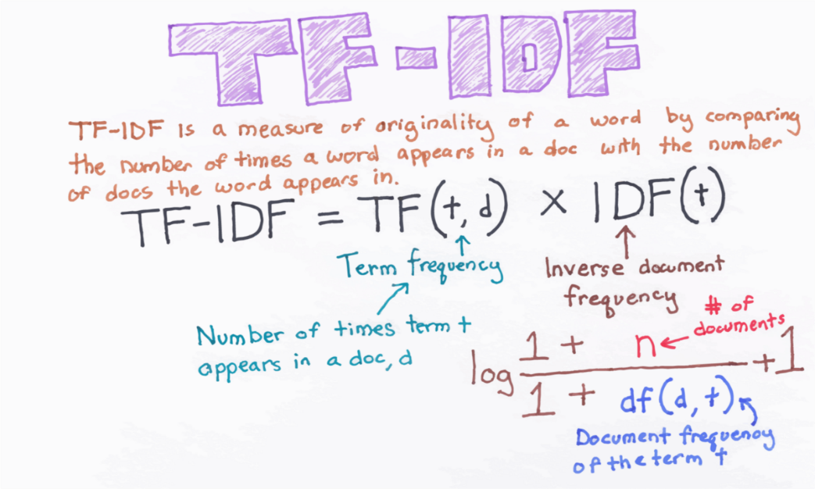
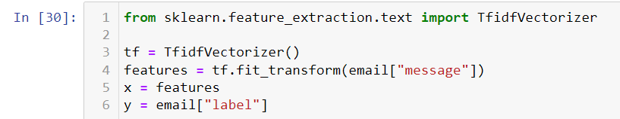
Tf-Idf vectorization:

Slide 13
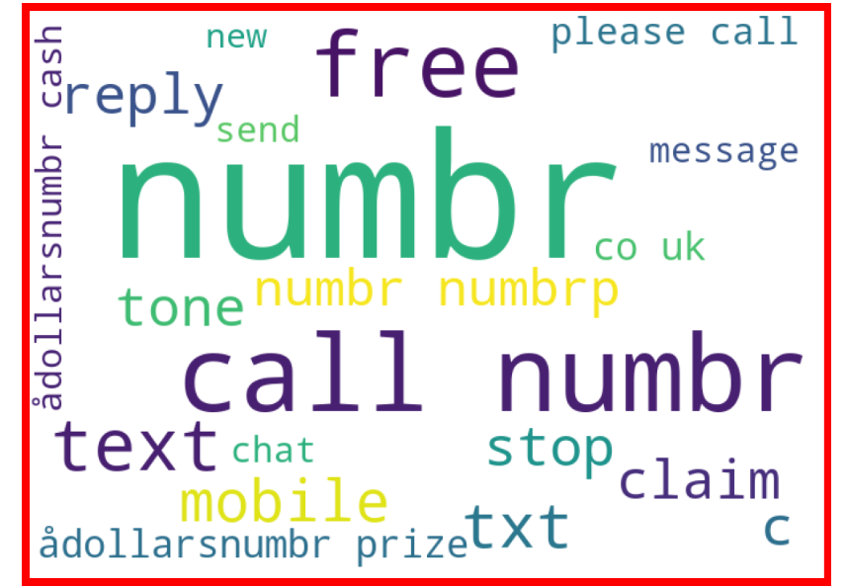
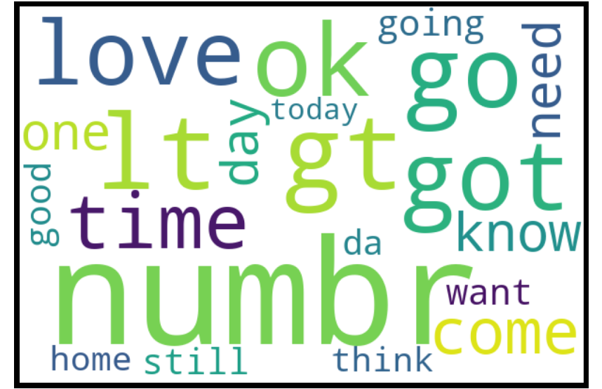
Visualisation:
Word Cloud: Word Cloud is a data visualization technique used for representing text data in which the size of each word indicates its frequency or importance. Significant textual data points can be highlighted using a word cloud. Word clouds are widely used for analyzing data from social network websites.

Slide 14
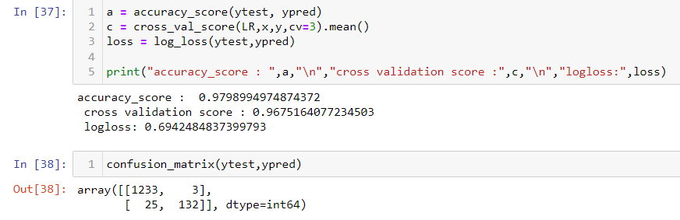
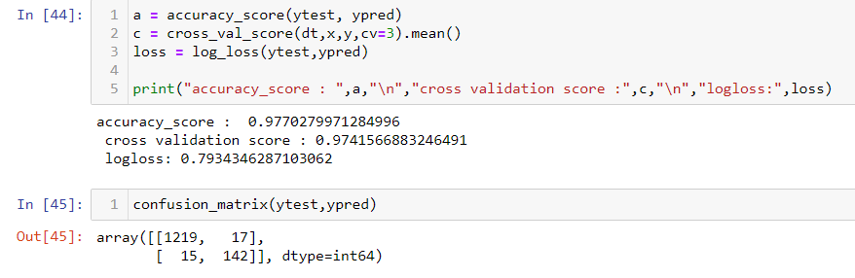
Model building:
1) Logistic Regression:
2) Decision Tree Classifier:

Slide 15
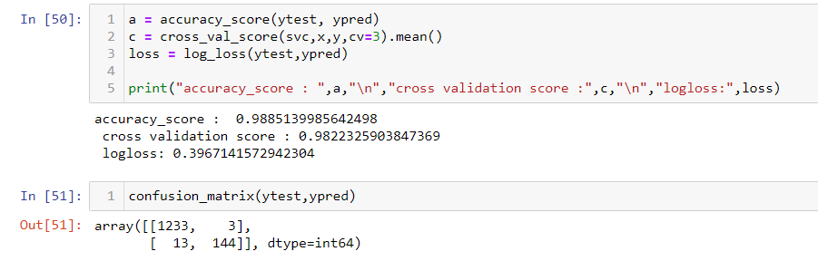
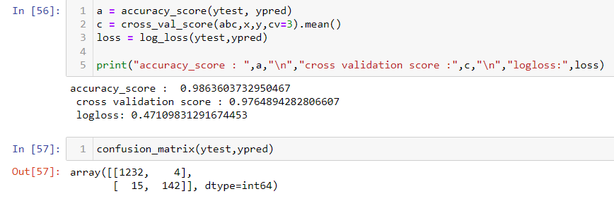
3) Linear Support Vector Machine Classifier:
4) Ada Boost Classifier:

Slide 16
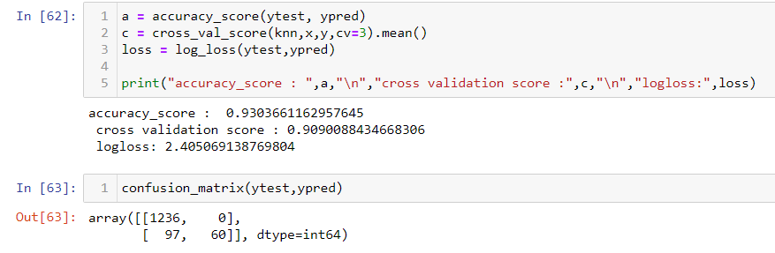
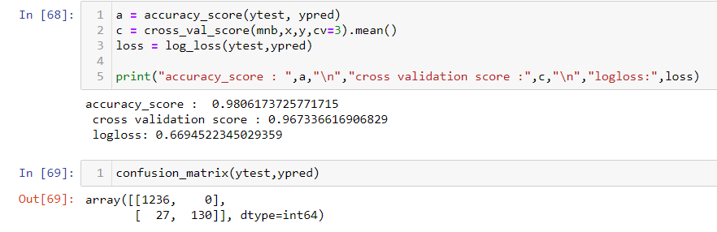
5) K-Neighbors Classifier:
6) Multinomial Naive Bayes Classifier:

Slide 17
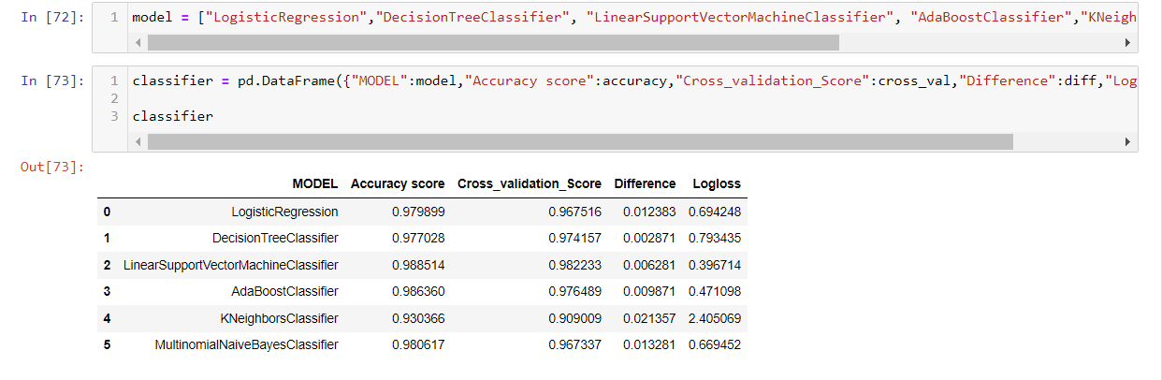
Comparison of different models:
As we can see, Linear Support Vector Machine Classifier is the best model.

Slide 18
Metrics:
Accuracy score
Confusion matrix
Recall
Precision
Logloss
Auc roc curve

Slide 19
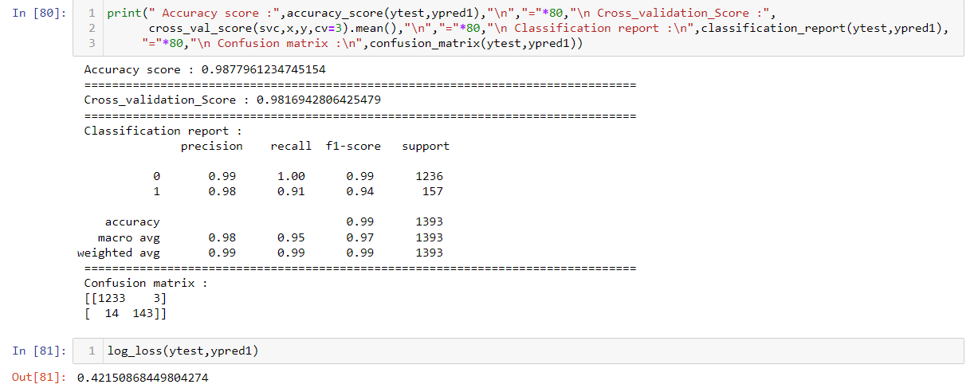

Slide 20
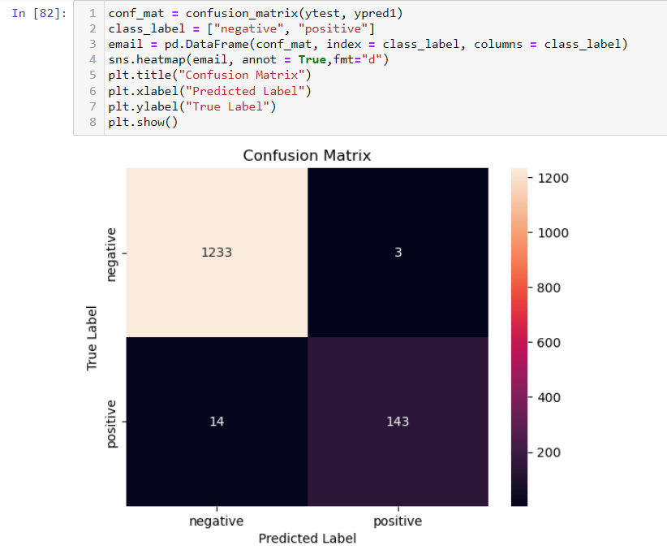

Slide 21
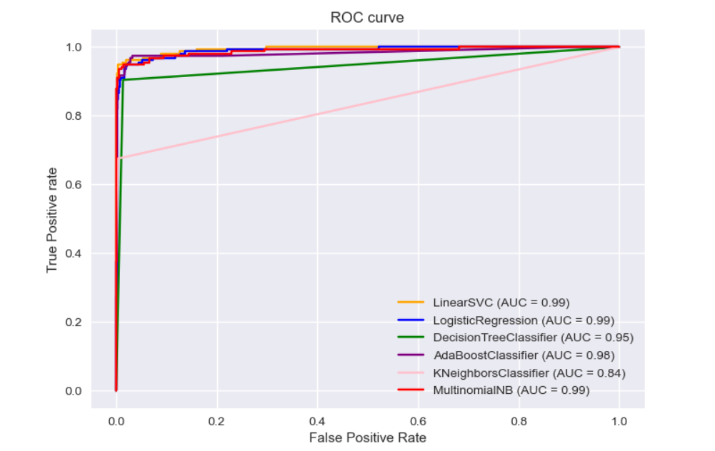

Slide 22
Conclusion:
Machine learning algorithms can be extensively applied in the field of spam filtering. Substantial work have been done to improve the effectiveness of spam filters for classifying emails as either ham (valid messages) or spam (unwanted messages) by means of ML classifiers. They have the ability to recognize distinctive characteristics of the contents of emails.

Slide 23


